Slide 1
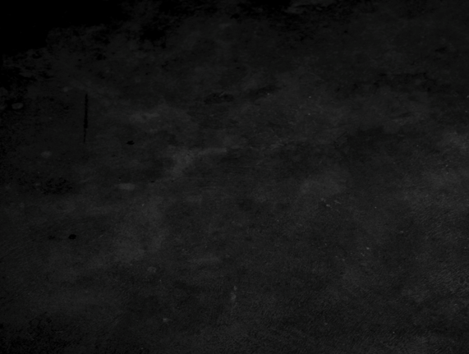















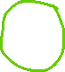




Unsupervised learning: clustering, dimensionality reduction
Angelo Ziletti, PhD
Principal Data Scientist, Bayer AG

Slide 2
Lecture Outline
Part 1.
Clustering (k-means, HDBSCAN)
1
Part 2.
Dimensionality reduction
(PCA, MDS, t-SNE, UMAP)
2
Part 3.
Examples (including one physics application)
3

Slide 3
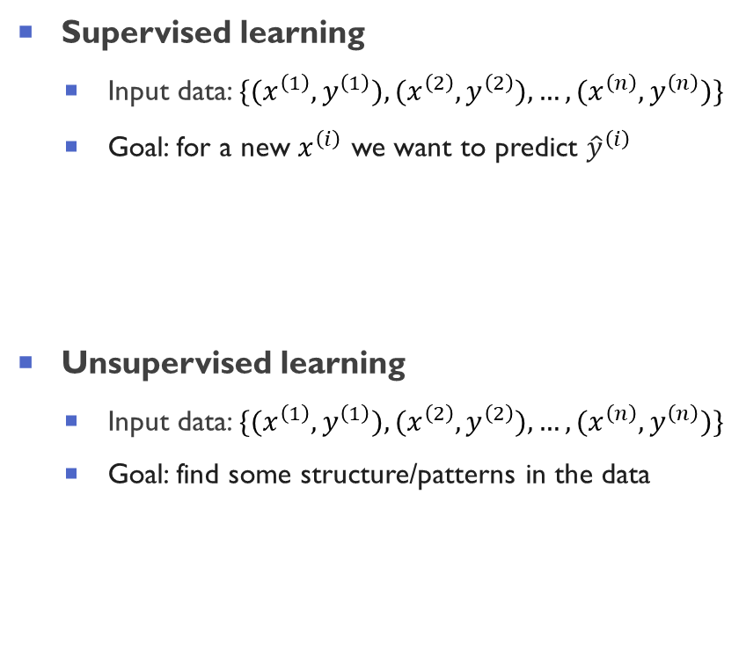

Unsupervised learning: definition
Supervised learning
Input data: $\{(x^{\left(1\right)},y^{\left(1\right)}),(x^{\left(2\right)},y^{\left(2\right)}),…,(x^{\left(n\right)},y^{\left(n\right)})\}$
Goal: for a new $x^{\left(ⅈ\right)}$ we want to predict ${\hat{y}}^{\left(ⅈ\right)}$
Unsupervised learning
Input data: $\{(x^{\left(1\right)},y^{\left(1\right)}),(x^{\left(2\right)},y^{\left(2\right)}),…,(x^{\left(n\right)},y^{\left(n\right)})\}$
Goal: find some structure/patterns in the data
Supervised learnings
Pros
Well defined and measurable goal
Algorithms are more advanced in this domain
Cons:
Limited in scope
Difficult to discover “what we do not know”
Unsupervised learning
Pros:
No label data are needed
Allows to “discover new things”
Cons:
Difficult to quantitative evaluate results
Requires investigation to obtain insights from results

Slide 4
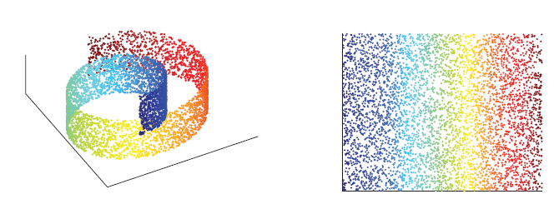
Two main types of unsupervised learning
Clustering:
Find groups (clusters) of similar items in a given dataset
Dimensionality reduction (or manifold learning):
Transform an initial representation of items into a lower-dimensional representation of these items while preserving some properties of the initial representation
Motivations:
Data compression
Visualization
Cluster 1
Cluster 3
Cluster 2
Figure from Mohri et al., Foundation of Machine Learning

Slide 5
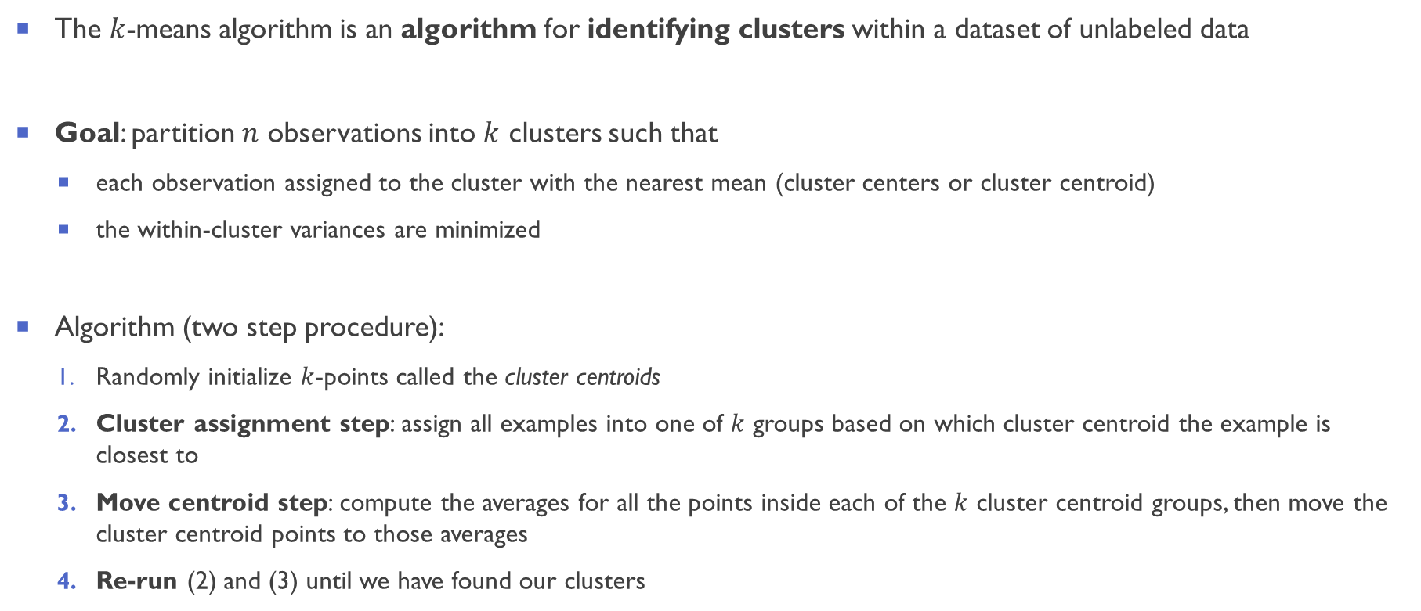
$k$-means clustering
The $k$-means algorithm is an algorithm for identifying clusters within a dataset of unlabeled data
Goal: partition $n$ observations into $k$ clusters such that
each observation assigned to the cluster with the nearest mean (cluster centers or cluster centroid)
the within-cluster variances are minimized
Algorithm (two step procedure):
Randomly initialize $k$-points called the cluster centroids
Cluster assignment step: assign all examples into one of $k$ groups based on which cluster centroid the example is closest to
Move centroid step: compute the averages for all the points inside each of the $k$ cluster centroid groups, then move the cluster centroid points to those averages
Re-run (2) and (3) until we have found our clusters

Slide 6





Slide 7
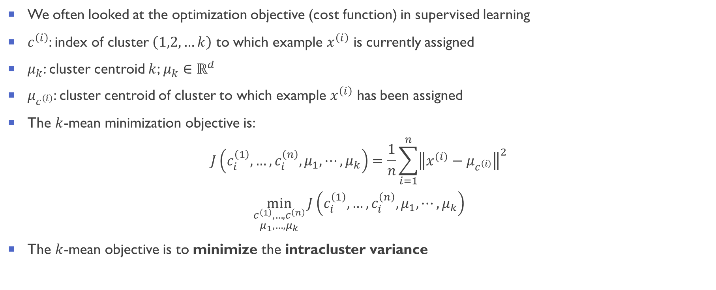

$k$-means: optimization objective
We often looked at the optimization objective (cost function) in supervised learning
$c^{\left(i\right)}$: index of cluster $\left(1,2,…k\right)$ to which example $x^{\left(i\right)}$ is currently assigned
$μ_{k}$: cluster centroid $k$; $μ_{k}∈ℝ^{d}$
$μ_{c^{\left(i\right)}}$: cluster centroid of cluster to which example $x^{\left(i\right)}$ has been assigned
The $k$-mean minimization objective is:
$$J\left(c_{i}^{\left(1\right)},…,c_{i}^{\left(n\right)},μ_{1},⋯,μ_{k}\right)=\frac{1}{n}\sum_{i=1}^{n}{{\left\|x^{(i)}−μ_{c^{\left(i\right)}}\right\|}^{2}}$$
$$\min_{\begin{aligned}c^{\left(1\right)},…,c^{\left(n\right)} \\ μ_{1},…,μ_{k}\end{aligned}}{J\left(c_{i}^{\left(1\right)},…,c_{i}^{\left(n\right)},μ_{1},⋯,μ_{k}\right)}$$
The $k$-mean objective is to minimize the intracluster variance

Slide 8
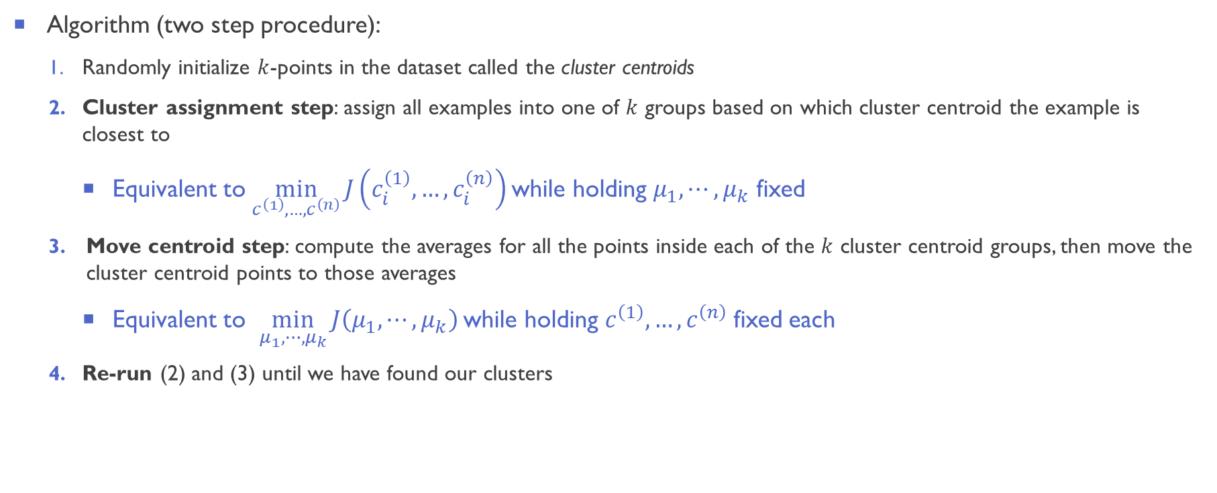
$k$-means optimization objective and $k$-means algorithm
Algorithm (two step procedure):
Randomly initialize $k$-points in the dataset called the cluster centroids
Cluster assignment step: assign all examples into one of $k$ groups based on which cluster centroid the example is closest to
Equivalent to $\min_{c^{\left(1\right)},…,c^{\left(n\right)}}{J\left(c_{i}^{\left(1\right)},…,c_{i}^{\left(n\right)}\right)}$while holding $μ_{1},⋯,μ_{k}$ fixed
Move centroid step: compute the averages for all the points inside each of the $k$ cluster centroid groups, then move the cluster centroid points to those averages
Equivalent to $\min_{μ_{1},⋯,μ_{k}}{J\left(μ_{1},⋯,μ_{k}\right)}$while holding $c^{\left(1\right)},…,c^{\left(n\right)}$fixed each
Re-run (2) and (3) until we have found our clusters

Slide 9
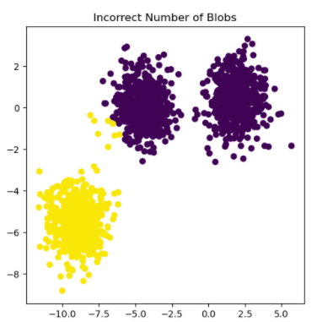
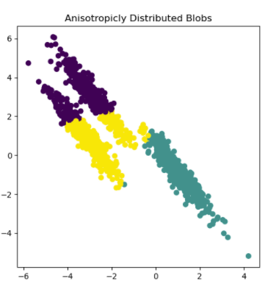
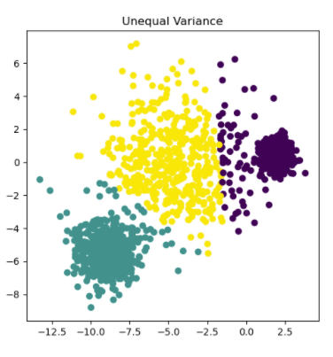
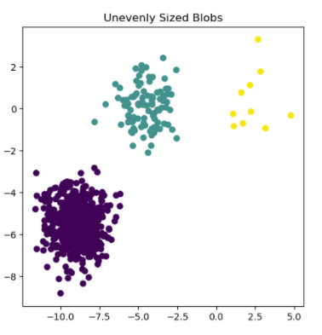
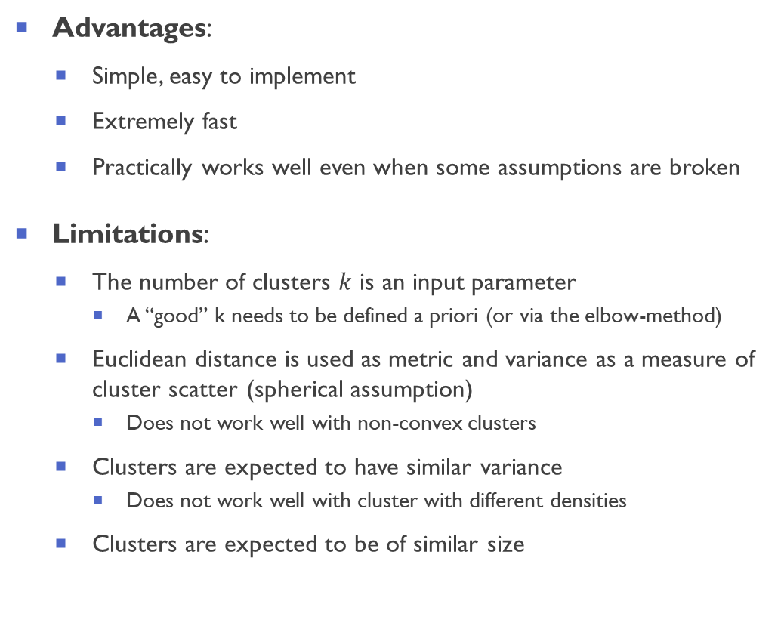
$k$-means shortcomings:
Advantages:
Simple, easy to implement
Extremely fast
Practically works well even when some assumptions are broken
Limitations:
The number of clusters $k$ is an input parameter
A “good” k needs to be defined a priori (or via the elbow-method)
Euclidean distance is used as metric and variance as a measure of cluster scatter (spherical assumption)
Does not work well with non-convex clusters
Clusters are expected to have similar variance
Does not work well with cluster with different densities
Clusters are expected to be of similar size
From scikit-learn 0.24.2 documentation

Slide 10
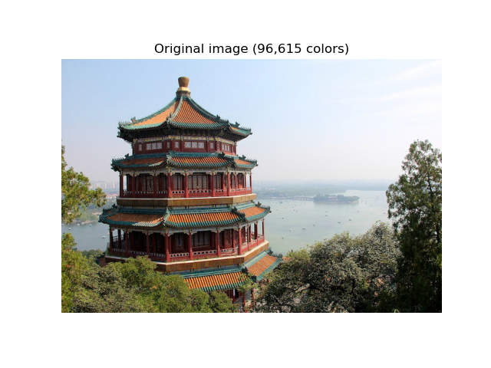


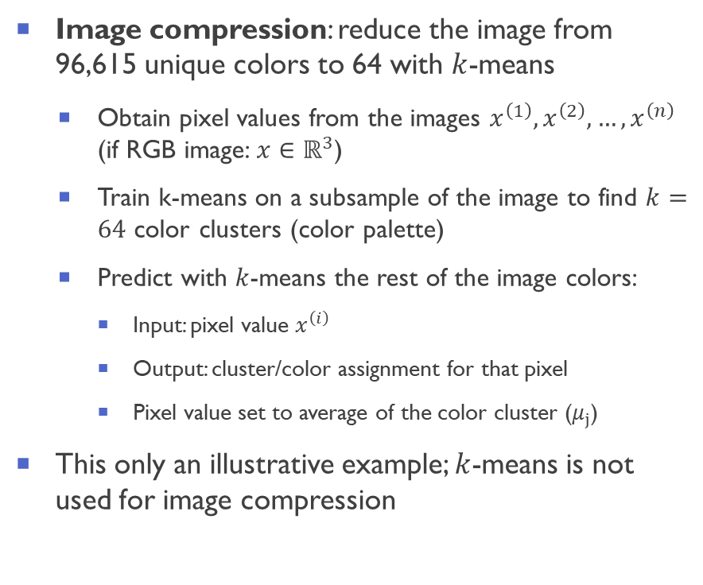
Example: color quantization using $k$-means
Image compression: reduce the image from 96,615 unique colors to 64 with $k$-means
Obtain pixel values from the images $x^{\left(1\right)},x^{\left(2\right)}, …,x^{\left(n\right)}$ (if RGB image: $x∈ℝ^{3}$)
Train k-means on a subsample of the image to find $k=64$ color clusters (color palette)
Predict with $k$-means the rest of the image colors:
Input: pixel value $x^{\left(i\right)}$
Output: cluster/color assignment for that pixel
Pixel value set to average of the color cluster ($μ_{j}$)
This only an illustrative example; $k$-means is not used for image compression
From Color Quantization using K-Means — scikit-learn 0.24.2 documentation

Slide 11
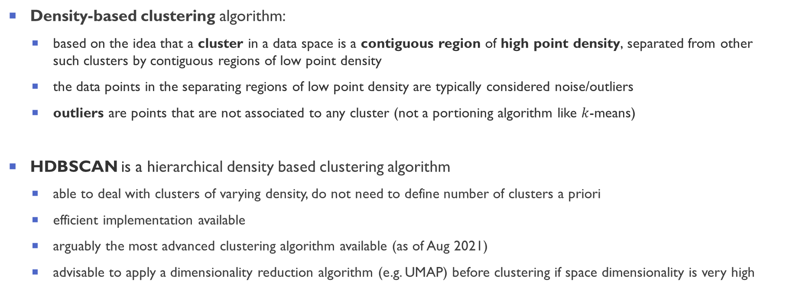
Hierarchical Density Based Spatial Clustering of Application and Noise (HDBSCAN)
Density-based clustering algorithm:
based on the idea that a cluster in a data space is a contiguous region of high point density, separated from other such clusters by contiguous regions of low point density
the data points in the separating regions of low point density are typically considered noise/outliers
outliers are points that are not associated to any cluster (not a portioning algorithm like $k$-means)
HDBSCAN is a hierarchical density based clustering algorithm
able to deal with clusters of varying density, do not need to define number of clusters a priori
efficient implementation available
arguably the most advanced clustering algorithm available (as of Aug 2021)
advisable to apply a dimensionality reduction algorithm (e.g. UMAP) before clustering if space dimensionality is very high
[DBSCAN Method] Ester et al., A density-based algorithm for discovering clusters in large spatial databases with noise, KDD-96. AAAI Press. pp. 226–231 (1996)
[HDBSCAN Method] Campello et al., “Density-based clustering based on hierarchical density estimates.,” in PAKDD vol. 7819, pp. 160-172, Springer (2013).
[HDBSCAN Implementation ] McInnes and Healy, “hdbscan: Hierarchical density based clustering.,” J. Open Source Softw., vol. 2, no. 11, p. 205 (2017)
The hdbscan Clustering Library — hdbscan 0.8.1 documentation

Slide 12
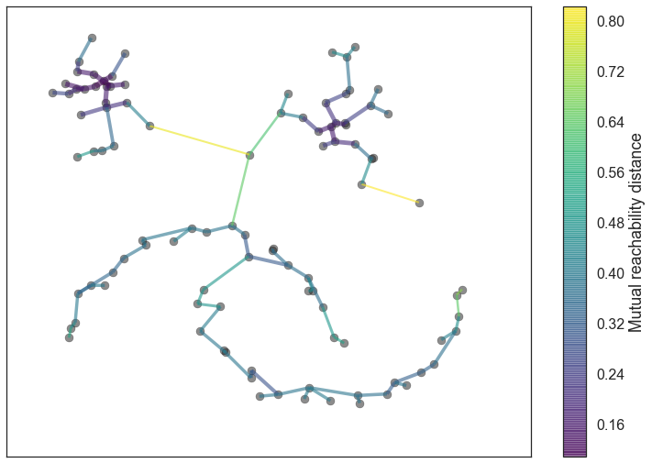
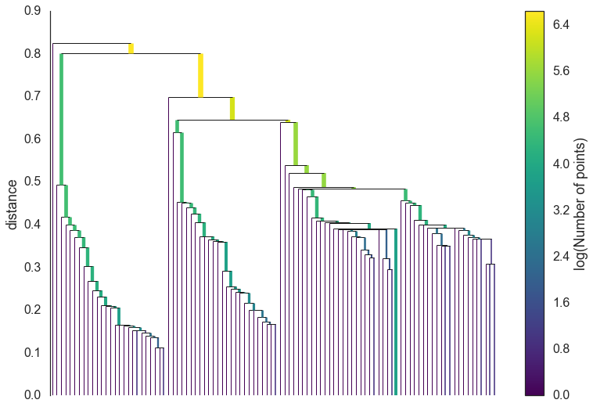
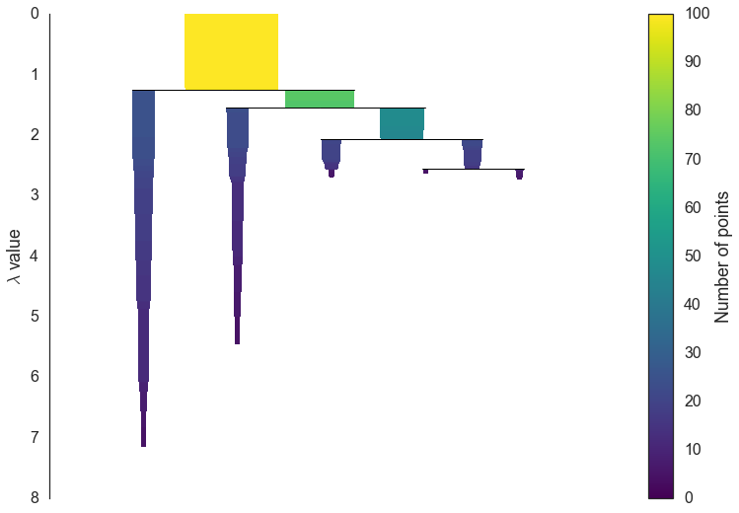
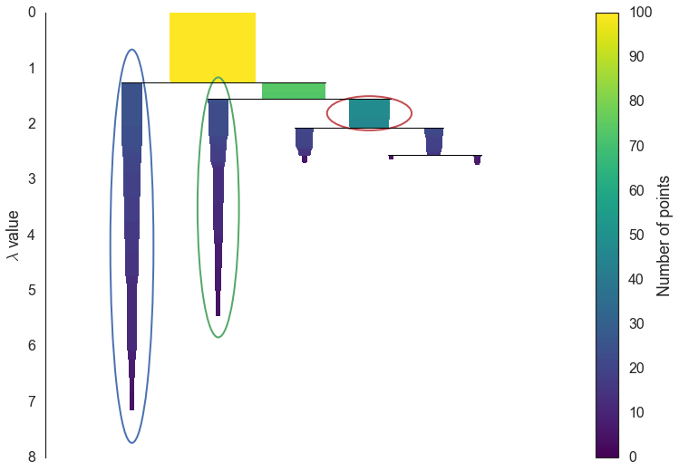
HDBSCAN algorithm: main steps
Four main steps:
Transform the space according to the density/sparsity of the data point sand build a minimum spanning tree
Construct a cluster hierarchy of connected components
Condense the cluster hierarchy on minimum cluster size
Extract the “stable” clusters from the condensed tree
[HDBSCAN Implementation ] McInnes and Healy, “hdbscan: Hierarchical density based clustering.,” J. Open Source Softw., vol. 2, no. 11, p. 205 (2017)
The hdbscan Clustering Library — hdbscan 0.8.1 documentation

Slide 13
HDBSCAN: build the minimum spanning tree
Get a rough estimate of the density
Transform the space according to the density/sparsity (via mutual reachability distance)
Dense regions stay roughly the same
Sparse regions become more sparse (they are going to be outliers)
This is because noise points between dense regions can cause the creation of unwanted bridges
Build the minimum spanning tree of the distance weighted graph
Connections are weighted by the mutual reachability distance
Find a minimal set of edges such that dropping any edge from the set causes a disconnection of components
[HDBSCAN Implementation ] McInnes and Healy, “hdbscan: Hierarchical density based clustering.,” The hdbscan Clustering Library — hdbscan 0.8.1 documentation

Slide 14


HDBSCAN: build the cluster hierarchy
High distance threshold:
one cluster will all points
Lowering distance threshold: clusters are split, more clusters are created
Low distance threshold:
Clusters with very few elements

Slide 15
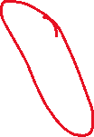
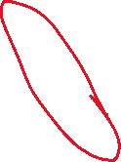
HDBSCAN: condensing the cluster hierarchy
Cluster extraction: condensing down the complicated cluster hierarchy into a smaller tree with a little more data attached to each node
It is often the case that a cluster split is one or two points splitting off from a cluster
rather than seeing it as a cluster splitting into two new clusters we want to view it as a single persistent cluster that is losing points
Define a parameter: minimum cluster size
Key idea: ask at each split “Has one of the new clusters created by the split fewer points than the minimum cluster size?”
If yes: ‘points falling out of a cluster’ → neglect the split, and keep have the parent (larger) cluster
If no: split is into two clusters each at least as large as the minimum cluster size → true cluster split
Minimum cluster size defines the clustering granularity (depends on the overall goal of the analysis)
[HDBSCAN Implementation ] McInnes and Healy, “hdbscan: Hierarchical density based clustering.,” The hdbscan Clustering Library — hdbscan 0.8.1 documentation

Slide 16
HDBSCAN: condensed cluster hierarchy
After walking through the whole hierarchy and condensing the clusters according to min cluster size, we obtain a much smaller tree with a small number of nodes
We can visualize this as a dendrogram (width of the line represent the number of points in the cluster.)
The width varies over the length of the line as points fall out of the cluster
Min cluster size = 5
[HDBSCAN Implementation ] McInnes and Healy, “hdbscan: Hierarchical density based clustering.,” The hdbscan Clustering Library — hdbscan 0.8.1 documentation

Slide 17




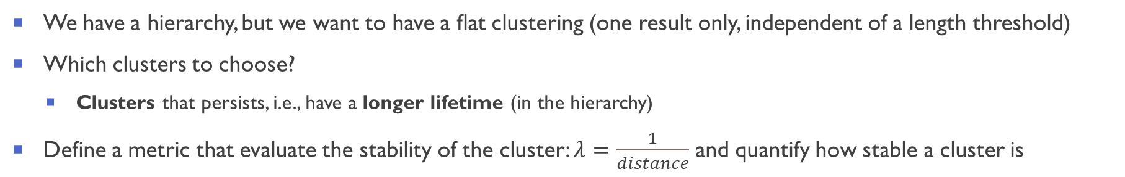






HDSCAN: obtain a flat clustering choosing the clusters
We have a hierarchy, but we want to have a flat clustering (one result only, independent of a length threshold)
Which clusters to choose?
Clusters that persists, i.e., have a longer lifetime (in the hierarchy)
Define a metric that evaluate the stability of the cluster: $λ=\frac{1}{distance}$ and quantify how stable a cluster is

Slide 18
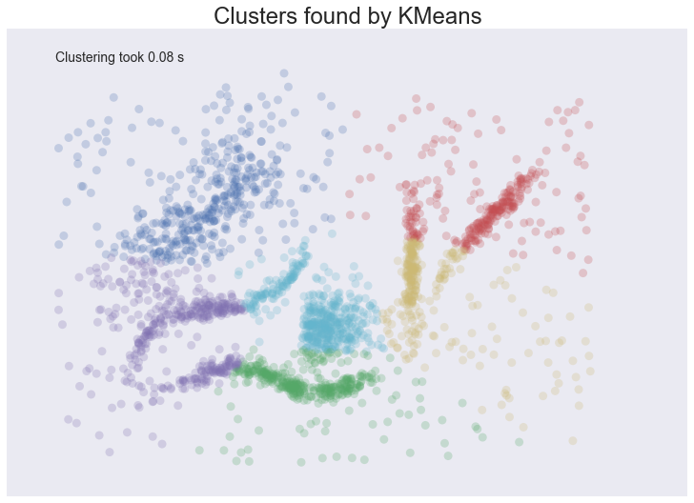
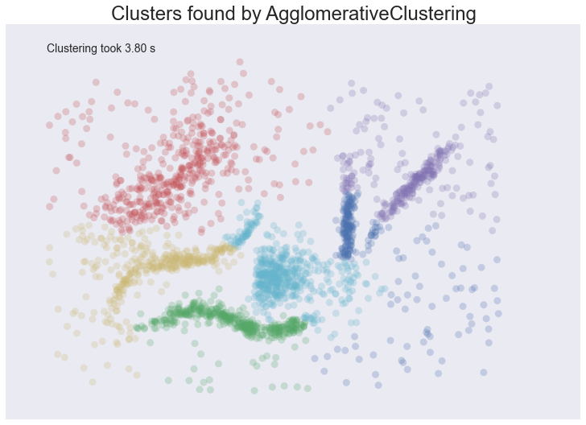
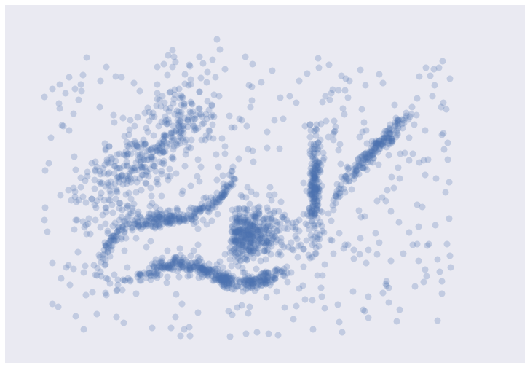
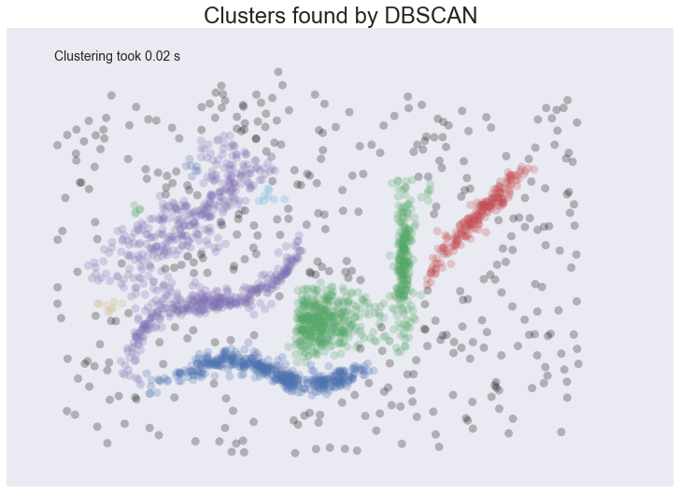
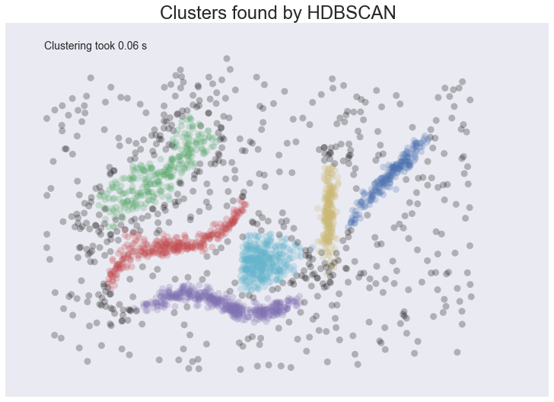
HDBSCAN: comparison with other algorithms
[HDBSCAN Implementation ] McInnes and Healy, “hdbscan: Hierarchical density based clustering.,” The hdbscan Clustering Library — hdbscan 0.8.1 documentation

Slide 19
Lecture Outline
Part 1.
Clustering (k-means, HDBSCAN)
1
Part 2.
Dimensionality reduction
(PCA, MDS, t-SNE, UMAP)
2
Part 3.
Examples (including one physics application)
3

Slide 20
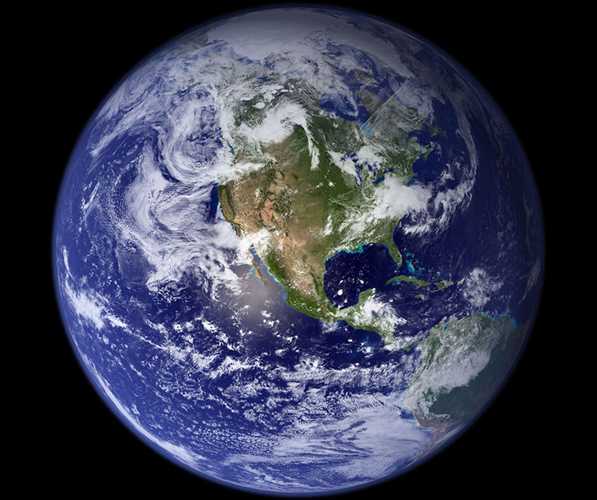
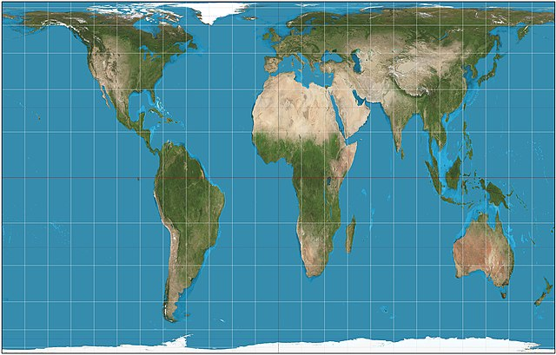
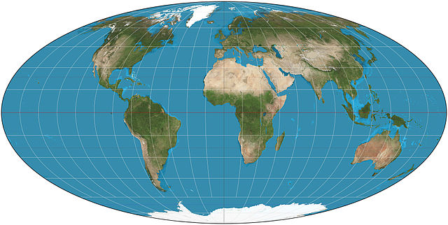
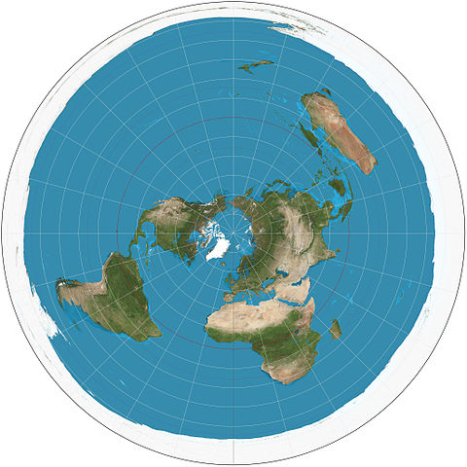
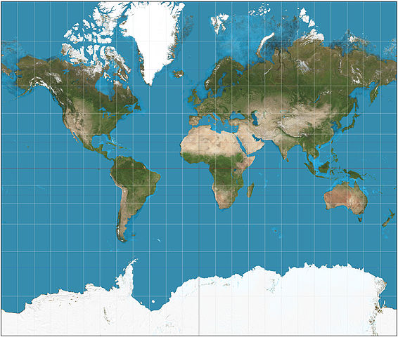


Dimensionality reduction
Dimensionality reduction: the transformation of data from a high-dimensional space into a low-dimensional space
Ideally the dimensionality of the low-dimensional representation close to the data intrinsic dimensionality
The intrinsic dimension for a data set can be thought of as the number of variables needed in a minimal representation of the data (usually unknown)
The goal is that the low-dimensional representation retains some meaningful properties of the original representation
For example, reproduce distances in higher-dimensional space inside the lower-dimensional map, as closely as possible
This is in general impossible: cartographer's dilemma (video: The Cartographer's Dilemma | National Geographic Society)
Choices to be made: what to preserve, and how many dimensions (e.g. 2D)
Images from Earth from space: 15 amazing things in 15 years (nasa.gov) and Wikipedia World map - Wikipedia

Slide 21
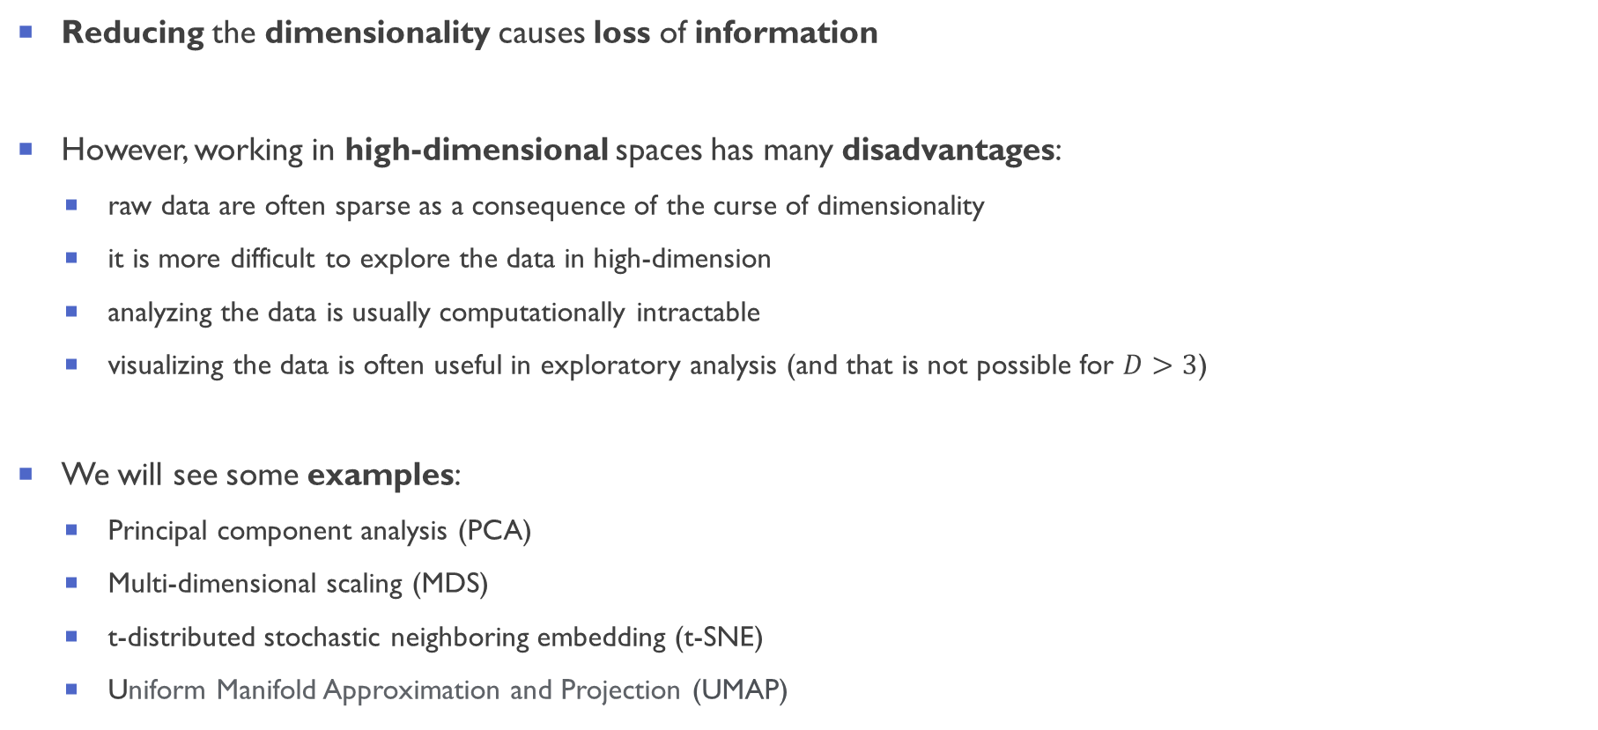
Dimensionality reduction: pros, cons, examples
Reducing the dimensionality causes loss of information
However, working in high-dimensional spaces has many disadvantages:
raw data are often sparse as a consequence of the curse of dimensionality
it is more difficult to explore the data in high-dimension
analyzing the data is usually computationally intractable
visualizing the data is often useful in exploratory analysis (and that is not possible for $D>3$)
We will see some examples:
Principal component analysis (PCA)
Multi-dimensional scaling (MDS)
t-distributed stochastic neighboring embedding (t-SNE)
Uniform Manifold Approximation and Projection (UMAP)

Slide 22


Principal Component Analysis (PCA)
PCA is the simplest dimensionality reduction algorithm
PCA is an uses an orthogonal transformation that converts a set of observations of (possibly correlated) variables into a set of values of linearly uncorrelated variables
These new coordinates are called principal components
PCA choses the principal components that retains as much as possible of the variation (variance) present in the data set
The first principal component has the greatest variance of the data by some scalar projection
the second greatest variance on the second coordinate, and so on
PCA can be used for reducing dimensionality by eliminating the later principal components
Notes:
Main question: Is there another basis, which is a linear combination of the original basis, that best re-expresses our data set?

Slide 23
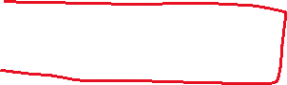


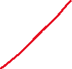

Slide 24


Slide 25






Slide 26







Slide 27
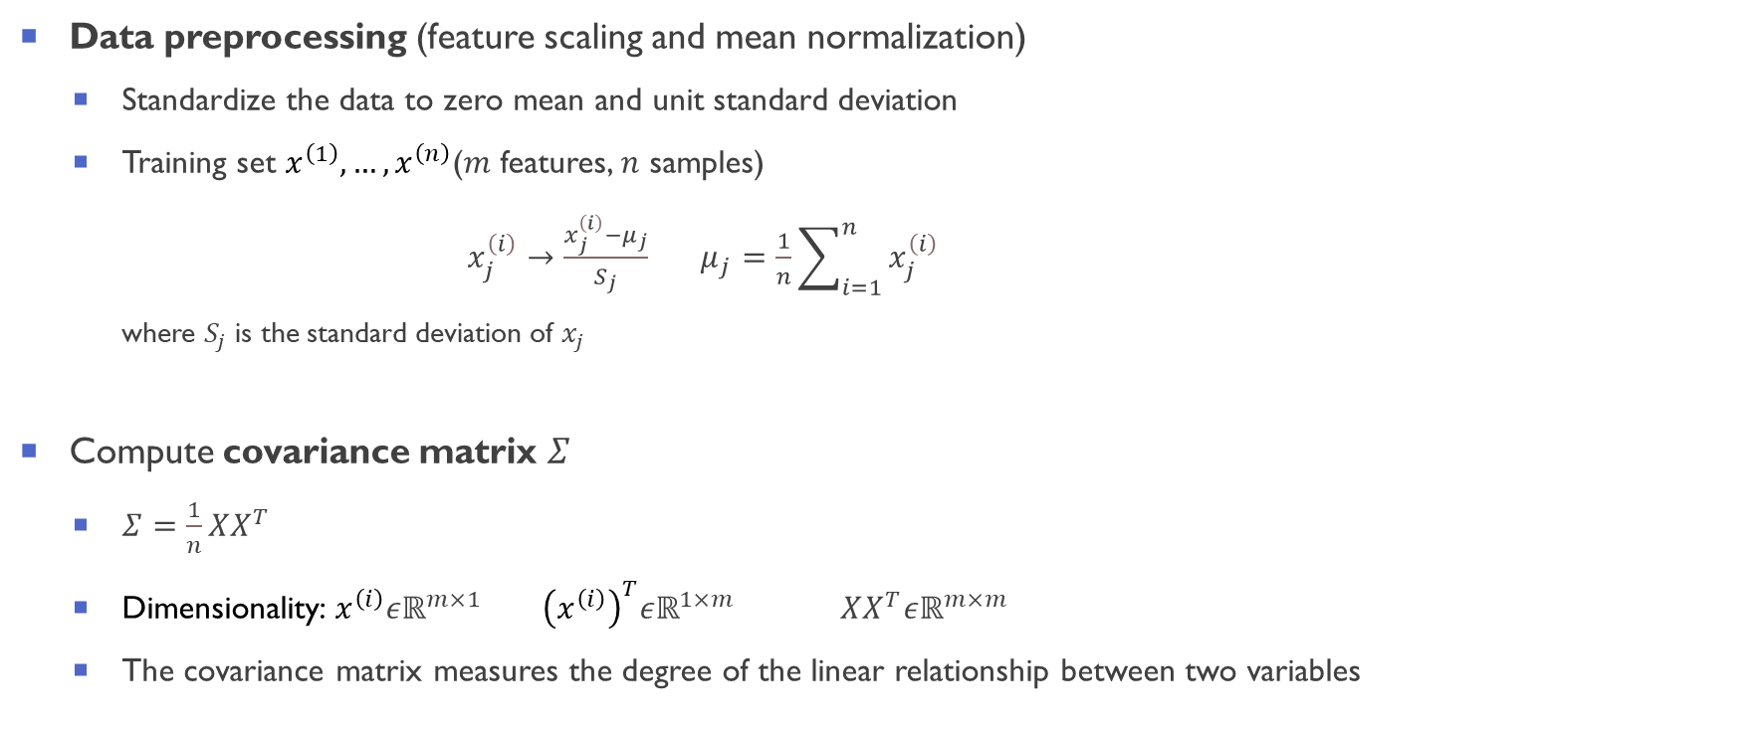
PCA algorithm
Data preprocessing (feature scaling and mean normalization)
Standardize the data to zero mean and unit standard deviation
Training set $x^{\left(1\right)}, …,x^{\left(n\right)}$($m$ features, $n$ samples)
$x_{j}^{\left(i\right)}→\frac{x_{j}^{\left(i\right)}−μ_{j}}{S_{j}}$ $μ_{j}=\frac{1}{n}\sum_{i=1}^{n}{x_{j}^{\left(i\right)}}$
where $S_{j}$ is the standard deviation of $x_{j}$
Compute covariance matrix $Σ$
$Σ=\frac{1}{n}XX^{T}$
Dimensionality: $x^{\left(i\right)}εℝ^{m×1}$ ${\left(x^{\left(ⅈ\right)}\right)}^{T}εℝ^{1×m}$ $XX^{T}εℝ^{m×m}$
The covariance matrix measures the degree of the linear relationship between two variables

Slide 28
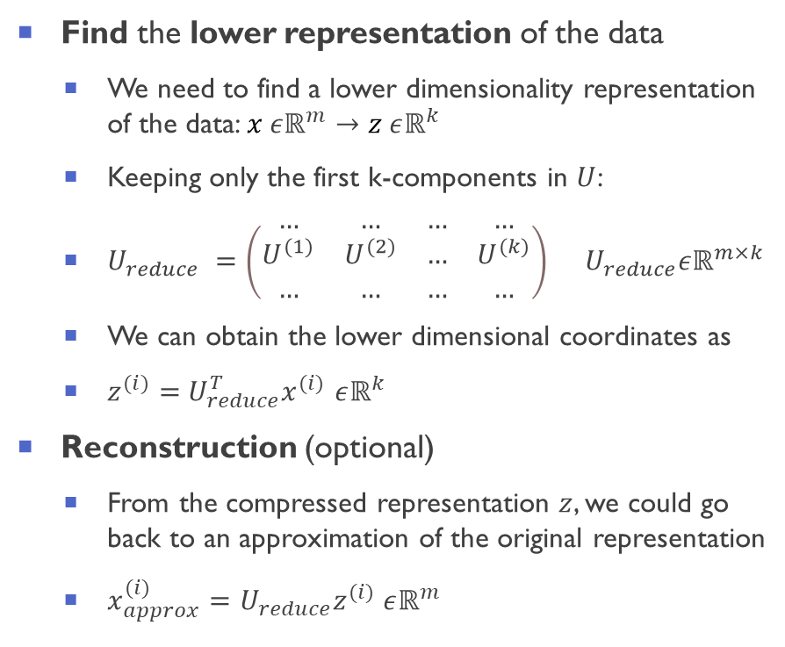
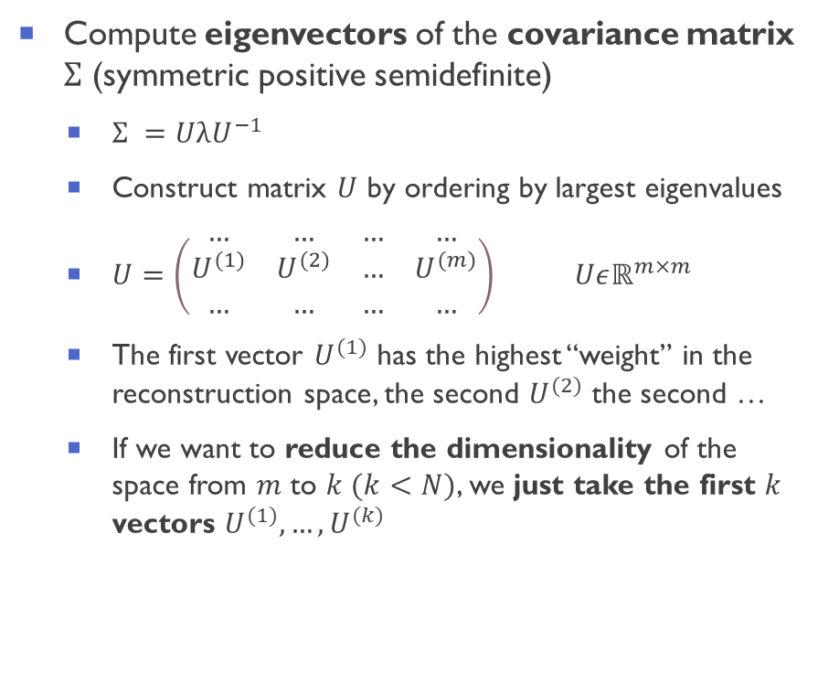
PCA algorithm
Compute eigenvectors of the covariance matrix $Σ$ (symmetric positive semidefinite)
$Σ =$ $UλU^{−1}$
Construct matrix $U$ by ordering by largest eigenvalues
$U=\left(\begin{matrix}… & … & … & … \\ U^{(1)} & U^{(2)} & … & U^{(m)} \\ … & … & … & …\end{matrix}\right)$ $Uεℝ^{m×m}$
The first vector $U^{(1)}$ has the highest “weight” in the reconstruction space, the second $U^{(2)}$ the second …
If we want to reduce the dimensionality of the space from $m$ to $k (k<N)$, we just take the first $k$ vectors $U^{(1)},…,U^{(k)}$
Find the lower representation of the data
We need to find a lower dimensionality representation of the data: $x εℝ^{m}→z εℝ^{k}$
Keeping only the first k-components in $U$:
$U_{reduce} =\left(\begin{matrix}… & … & … & … \\ U^{(1)} & U^{(2)} & … & U^{(k)} \\ … & … & … & …\end{matrix}\right) U_{reduce}εℝ^{m×k}$
We can obtain the lower dimensional coordinates as
$z^{(i)}=$ $U_{reduce}^{T}x^{(i)}$ $εℝ^{k}$
Reconstruction (optional)
From the compressed representation $z$, we could go back to an approximation of the original representation
$x_{approx}^{(i)}=U_{reduce}z^{(i)}$ $εℝ^{m}$

Slide 29
PCA: advantages and disadvantages
Advantages:
non-parametric: it does not have any input parameter to tweak
clear mathematical interpretation
Disadvantages:
looks only for linear transformation of the data
cannot deal with categorical features
depends on the scaling of variables

Slide 30


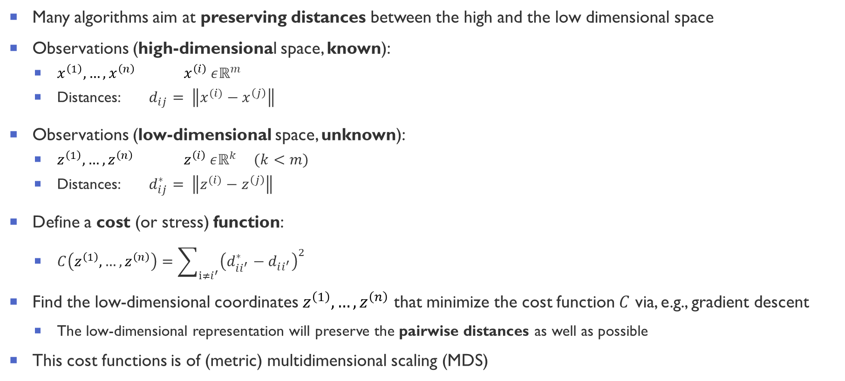
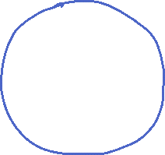
Optimization-based dimensionality reduction (and multidimensional scaling, MDS)
Many algorithms aim at preserving distances between the high and the low dimensional space
Observations (high-dimensional space, known):
$x^{\left(1\right)}, …,x^{\left(n\right)}$ $x^{\left(i\right)} εℝ^{m}$
Distances: $d_{ij}= \left\|x^{(ⅈ)}−x^{\left(j\right)}\right\|$
Observations (low-dimensional space, unknown):
$z^{\left(1\right)}, …,z^{\left(n\right)}$ $z^{\left(i\right)} εℝ^{k}$ $(k<m)$
Distances: $d_{ij}^{∗}= \left\|z^{(ⅈ)}−z^{\left(j\right)}\right\|$
Define a cost (or stress) function:
$C\left(z^{\left(1\right)}, …,z^{\left(n\right)}\right)=\sum_{ⅈ≠i^{′}}{{\left(d_{ii^{′}}^{∗}−d_{ii^{′}}\right)}^{2}}$
Find the low-dimensional coordinates $z^{\left(1\right)}, …,z^{\left(n\right)}$ that minimize the cost function $C$ via, e.g., gradient descent
The low-dimensional representation will preserve the pairwise distances as well as possible
This cost functions is of (metric) multidimensional scaling (MDS)

Slide 31
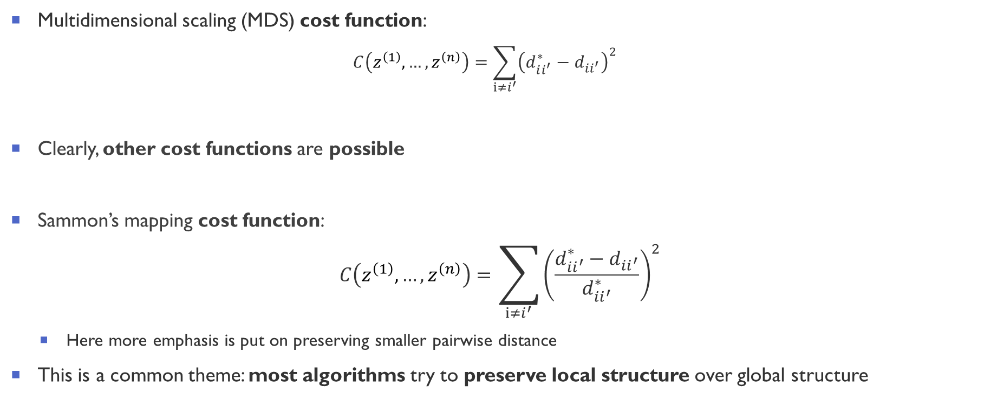
Multidimensional scaling (MDS), Sammon’s mapping, Graph-based
Multidimensional scaling (MDS) cost function:
$$C\left(z^{\left(1\right)}, …,z^{\left(n\right)}\right)=\sum_{ⅈ≠i^{′}}{{\left(d_{ii^{′}}^{∗}−d_{ii^{′}}\right)}^{2}}$$
Clearly, other cost functions are possible
Sammon’s mapping cost function:
$$C\left(z^{\left(1\right)}, …,z^{\left(n\right)}\right)=\sum_{ⅈ≠i^{′}}{{\left(\frac{d_{ii^{′}}^{∗}−d_{ii^{′}}}{d_{ii^{′}}^{∗}}\right)}^{2}}$$
Here more emphasis is put on preserving smaller pairwise distance
This is a common theme: most algorithms try to preserve local structure over global structure

Slide 32
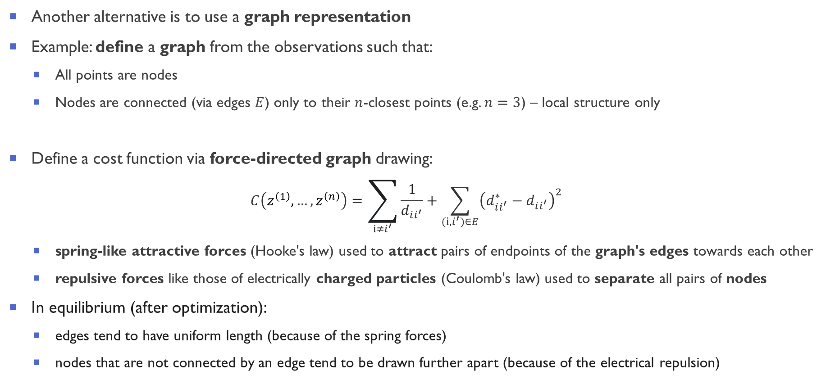

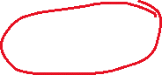
Graph-based visualization: force-directed graph drawings
Another alternative is to use a graph representation
Example: define a graph from the observations such that:
All points are nodes
Nodes are connected (via edges $E$) only to their $n$-closest points (e.g. $n=3$) – local structure only
Define a cost function via force-directed graph drawing:
$$C\left(z^{\left(1\right)}, …,z^{\left(n\right)}\right)=\sum_{ⅈ≠i^{′}}{\frac{1}{d_{ii^{′}}}}+\sum_{(ⅈ,i^{′})∈E}{{\left(d_{ii^{′}}^{∗}−d_{ii^{′}}\right)}^{2}}$$
spring-like attractive forces (Hooke's law) used to attract pairs of endpoints of the graph's edges towards each other
repulsive forces like those of electrically charged particles (Coulomb's law) used to separate all pairs of nodes
In equilibrium (after optimization):
edges tend to have uniform length (because of the spring forces)
nodes that are not connected by an edge tend to be drawn further apart (because of the electrical repulsion)

Slide 33
t-distributed stochastic neighbor embedding (t-SNE)
t-SNE is a machine learning algorithm for dimensionality reduction
Particularly suited for embedding high-dimensional data into 2D or 3D
It is still one of the most used algorithms for visualization
Only recently surpassed in popularity by UMAP
Pro: It generates visually pleasing maps, works well on a wide range of datasets
Cons: It can be slow in high dimensions, results can depend strongly on parameters
Main idea:
Construct a probability distribution by placing Gaussian over each datapoint in high-dimensional space
Construct a similar probability distribution in low-dimensional space (using a t-distribution instead)
Find points in low dimensions such that these two distributions are as similar as possible (minimizing a cost function)
[t-SNE] van der Maaten and Hinton, "Visualizing Data Using t-SNE" Journal of Machine Learning Research. 9: 2579–2605 (2008)

Slide 34
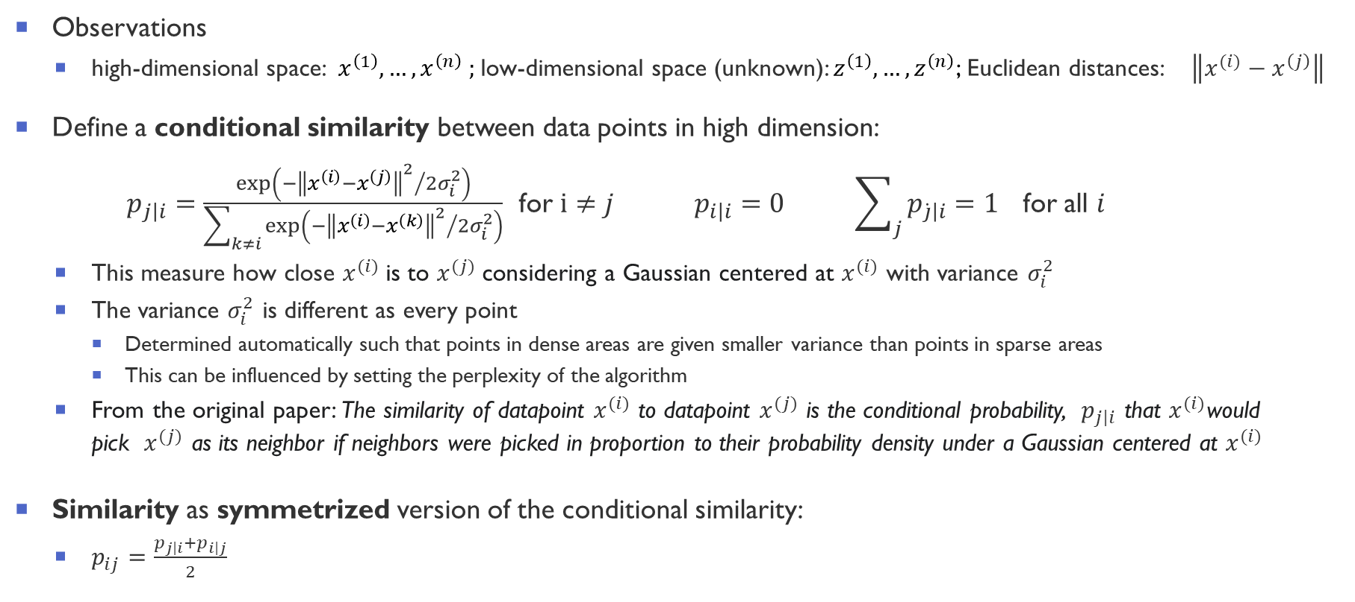
t-SNE: algorithm: high-dimensional space
Observations
high-dimensional space: $x^{\left(1\right)}, …,x^{\left(n\right)} ;$low-dimensional space (unknown): $z^{\left(1\right)}, …,z^{\left(n\right)}$; Euclidean distances: $\left\|x^{(ⅈ)}−x^{\left(j\right)}\right\|$
Define a conditional similarity between data points in high dimension:
$p_{\left.j\right|i}=\frac{\exp\left(−{{\left\|x^{\left(i\right)}−x^{\left(j\right)}\right\|}^{2}}/2σ_{i}^{2}\right)}{\sum_{k≠i}{\exp\left(−{{\left\|x^{\left(i\right)}−x^{\left(k\right)}\right\|}^{2}}/2σ_{i}^{2}\right)}}$ for $ⅈ≠j$ $p_{\left.i\right|i}=0$ $\sum_{j}{p_{\left.\dot{j}\right|i}}=1$ for all $i$
This measure how close $x^{(ⅈ)}$is to $x^{(j)}$considering a Gaussian centered at $x^{(ⅈ)}$ with variance $σ_{i}^{2}$
The variance $σ_{i}^{2}$ is different as every point
Determined automatically such that points in dense areas are given smaller variance than points in sparse areas
This can be influenced by setting the perplexity of the algorithm
From the original paper: The similarity of datapoint $x^{(ⅈ)}$ to datapoint $x^{(j)}$ is the conditional probability, $p_{\left.j\right|i}$ that $x^{(ⅈ)}$would pick $x^{(j)}$ as its neighbor if neighbors were picked in proportion to their probability density under a Gaussian centered at $x^{(ⅈ)}$
Similarity as symmetrized version of the conditional similarity:
$p_{ij}=\frac{p_{\left.j\right|i}+p_{\left.i\right|j}}{2}$
[t-SNE] van der Maaten and Hinton, "Visualizing Data Using t-SNE" Journal of Machine Learning Research. 9: 2579–2605 (2008)

Slide 35
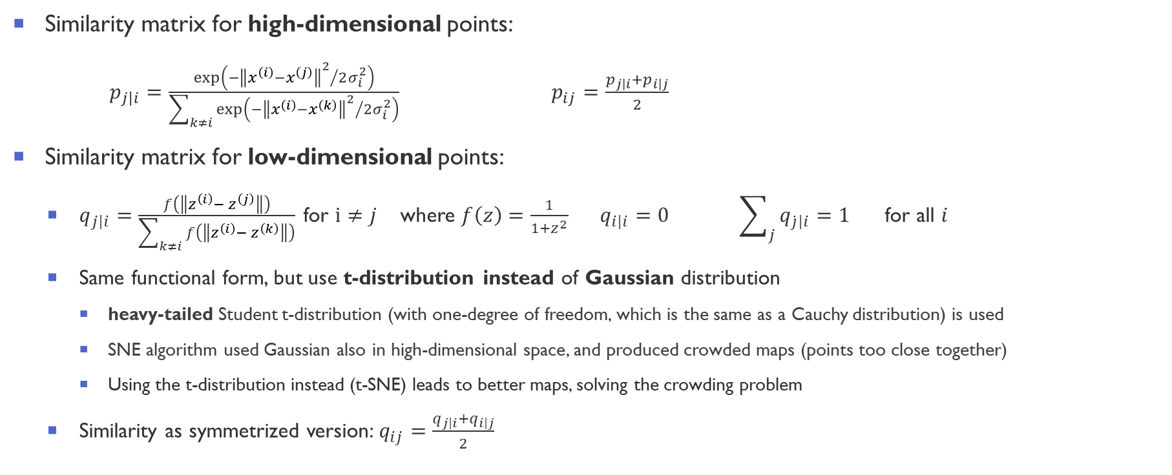
t-SNE: algorithm: low dimensional space
Similarity matrix for high-dimensional points:
$p_{\left.j\right|i}=\frac{\exp\left(−{{\left\|x^{\left(i\right)}−x^{\left(j\right)}\right\|}^{2}}/2σ_{i}^{2}\right)}{\sum_{k≠i}{\exp\left(−{{\left\|x^{\left(i\right)}−x^{\left(k\right)}\right\|}^{2}}/2σ_{i}^{2}\right)}}$ $p_{ij}=\frac{p_{\left.j\right|i}+p_{\left.i\right|j}}{2}$
Similarity matrix for low-dimensional points:
$q_{\left.j\right|i}=\frac{f\left(\left\|z^{\left(i\right)}−{ z}^{\left(j\right)}\right\|\right)}{\sum_{k≠i}{f\left(\left\|z^{\left(i\right)}−{ z}^{\left(k\right)}\right\|\right)}}$ for $ⅈ≠j$ where $f\left(z\right)=\frac{1}{1+z^{2}}$ $q_{\left.i\right|i}=0$ $\sum_{j}{q_{\left.\dot{j}\right|i}}=1$ for all $i$
Same functional form, but use t-distribution instead of Gaussian distribution
heavy-tailed Student t-distribution (with one-degree of freedom, which is the same as a Cauchy distribution) is used
SNE algorithm used Gaussian also in high-dimensional space, and produced crowded maps (points too close together)
Using the t-distribution instead (t-SNE) leads to better maps, solving the crowding problem
Similarity as symmetrized version: $q_{ij}=\frac{q_{\left.j\right|i}+q_{\left.i\right|j}}{2}$
[t-SNE] van der Maaten and Hinton, "Visualizing Data Using t-SNE" Journal of Machine Learning Research. 9: 2579–2605 (2008)
[SNE] Roweis and Hinton, Stochastic neighbor embedding, NIPS (2002)

Slide 36
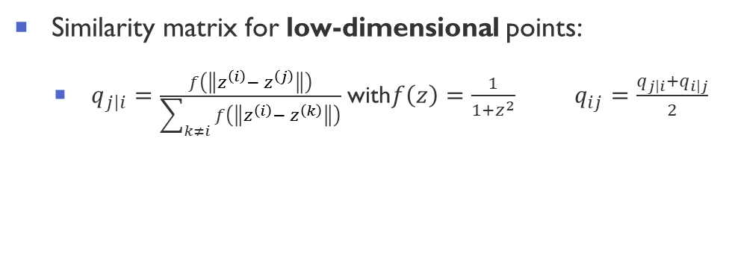
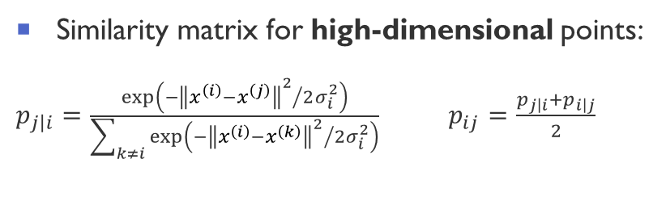
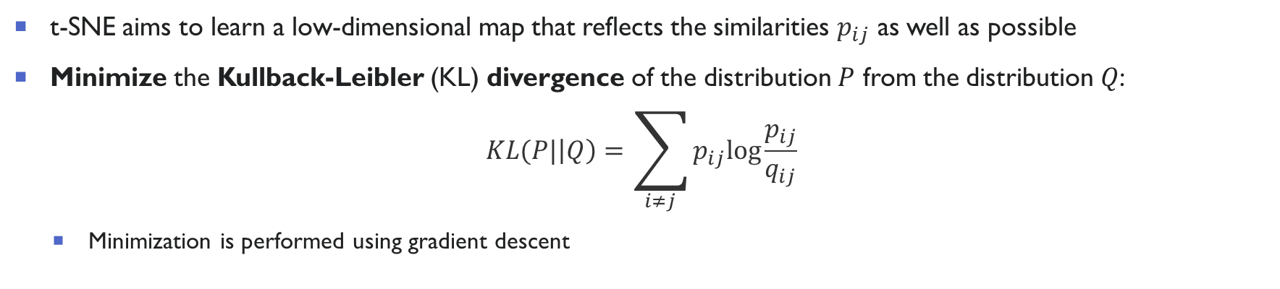
t-SNE: algorithm: Kullback-Leibler (KL) divergence
Similarity matrix for high-dimensional points:
$p_{\left.j\right|i}=\frac{\exp\left(−{{\left\|x^{\left(i\right)}−x^{\left(j\right)}\right\|}^{2}}/2σ_{i}^{2}\right)}{\sum_{k≠i}{\exp\left(−{{\left\|x^{\left(i\right)}−x^{\left(k\right)}\right\|}^{2}}/2σ_{i}^{2}\right)}}$ $p_{ij}=\frac{p_{\left.j\right|i}+p_{\left.i\right|j}}{2}$
Similarity matrix for low-dimensional points:
$q_{\left.j\right|i}=\frac{f\left(\left\|z^{\left(i\right)}−{ z}^{\left(j\right)}\right\|\right)}{\sum_{k≠i}{f\left(\left\|z^{\left(i\right)}−{ z}^{\left(k\right)}\right\|\right)}}$ with$f\left(z\right)=\frac{1}{1+z^{2}}$ $q_{ij}=\frac{q_{\left.j\right|i}+q_{\left.i\right|j}}{2}$
t-SNE aims to learn a low-dimensional map that reflects the similarities $p_{ij}$ as well as possible
Minimize the Kullback-Leibler (KL) divergence of the distribution $P$ from the distribution $Q$:
$$KL(P|\left|Q\right)=\sum_{i≠j}{p_{ij}log\frac{p_{ij}}{q_{ij}}}$$
Minimization is performed using gradient descent

Slide 37

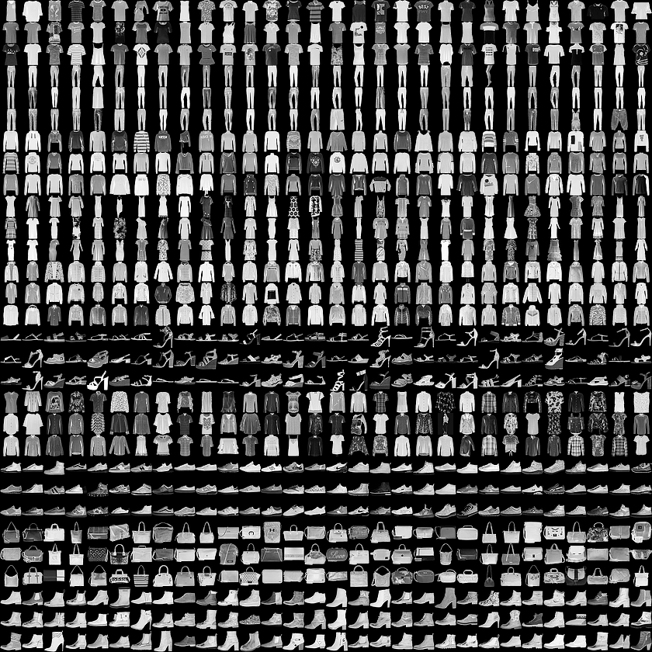
Example: MNIST dataset
MNIST (Modified National Institute of Standards and Technology database) is a large database of handwritten digits
60,000 training images and 10,000 testing images
Each image is a 28x28 grayscale image,
Labels: 10 classes (digits)
Example of dim. reduction on MNIST: Visualizing MNIST: An Exploration of Dimensionality Reduction - colah's blog
Fashion-MNIST is a database of Zalando’s article images
Drop-in replacement for MNIST
60,000 training images and 10,000 testing images
Each example is a 28x28 grayscale image, associated with a label from 10 classes
Labels: 10 classes (trousers, pullover, dress, coat, sandal…)
Figure from MNIST database - Wikipedia
[MNIST] LeCun et al., (1998), Proceedings of the IEEE, 86(11), 2278–2324 (1998)
[FashionMNIST] Xiao et al., arXiv:1708.07747 (2017); data available here: Fashion MNIST | Kaggle
Figure from zalandoresearch/fashion-mnist (github.com)

Slide 38
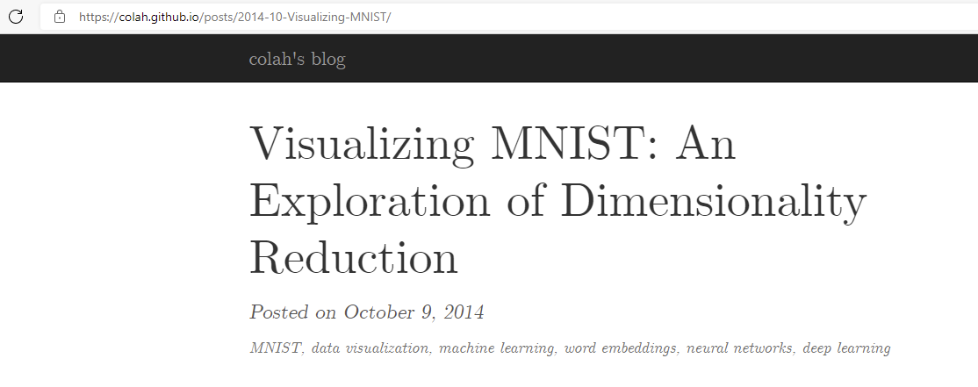

Visualizing MNIST: An Exploration of Dimensionality Reduction [DEMO]
Let us explore the various dimensionality reduction on the MNIST dataset via this great online article: Visualizing MNIST: An Exploration of Dimensionality Reduction - colah's blog
Link: https://colah.github.io/posts/2014-10-Visualizing-MNIST

Slide 39
Uniform Manifold Approximation and Projection (UMAP)
Dimensionality reduction technique based on graphs and fuzzy topology
For visualization, but also for general non-linear dimensionality reduction (in arbitrary dimension)
Arguably the most popular algorithm for dimensionality reduction as today (Aug 2021)
tends to preserve better the global structure of the data with respect to other algorithms (e.g, t-SNE)
Very fast: UMAP can project the 784-dimensional, 70,000-point MNIST dataset in less than 3 minutes, compared to 45 minutes for scikit-learn's t-SNE implementation
Two main steps:
Construct a fuzzy topological representation of the data (as a fuzzy graph)
Optimize the low dimensional representation to have as close fuzzy topological representation as possible
UMAP resources:
McInness et al., AriXiv: 1802.03426 (2018)
Code and excellent documentation on the algorithm: umap 0.5 documentation (umap-learn.readthedocs.io)
Video by the authors on the algorithm: UMAP presentation | SciPy 2018 | - YouTube

Slide 40



UMAP: how the high dimensional graph is built
To construct the initial high-dimensional graph, UMAP builds a fuzzy simplicial complex
It is a weighted graph, with edge weights representing the likelihood that two points are connected
To determine connectedness:
extends a radius outwards from each point, connecting points when those radii overlap
the radius is critical: too small → small, isolated clusters; too large → one big cluster
UMAP chooses a radius locally, based on the distance to each point's $n$-th nearest neighbor
Then makes the graph fuzzy by decreasing the likelihood of connection as the radius grows
Enforce that each point must be connected to at least its closest neighbor to ensures that local structure is preserved (in balance with global structure)
Reference: Understanding UMAP: Understanding UMAP (pair-code.github.io)

Slide 41


UMAP: finding a lower dimensional representation
Goal: preserve the fuzzy topology (as graph) as much as possible
The graph is composed by nodes, and edges (actually 0-simplices, 1-simplices)
Nodes are data points: they are the same in high and low dimension (we want to keep all points)
Edges: they are probability of points between connected (the graph is fuzzy)
$E$: set of all possible 1-simplices; $w_{h}(e)$ weight of edge $e$ in high dim; $w_{l}(e)$ weight of edge $e$ in low dimension
UMAP objective function is the cross entropy:
$$C=\sum_{e∈E}{w_{h}\left(ⅇ\right)\log{\frac{w_{h}\left(ⅇ\right)}{w_{l}\left(ⅇ\right)}}}+(1−w_{h}\left(ⅇ\right))\log{\frac{(1−w_{h}\left(ⅇ\right))}{(1−w_{l}\left(ⅇ\right))}}$$
It can be interpreted as force-directed graph layout algorithm:
Attractive force between $e$: when there is a large $w_{h}\left(ⅇ\right)$: term is minimized when $w_{l}\left(ⅇ\right)$ is as large as possible → strong connection between points → distance between points as small as possible
Repulsive force between $e$: when there is a small $w_{h}\left(ⅇ\right)$, term is minimized when $w_{l}\left(ⅇ\right)$ is as small as possible → no connection between points → distance between points large
Minimize $C$ via stochastic gradient descent

Slide 42
Lecture Outline
Part 1.
Clustering (k-means, HDBSCAN)
1
Part 2.
Dimensionality reduction
(PCA, MDS, t-SNE, UMAP)
2
Part 3.
Examples (including one physics application)
3

Slide 43

UMAP: dimensionality reduction on MNIST
MNIST dataset: handwritten digits from 0-9
Figure from MNIST database - Wikipedia
Image from https://github.com/lmcinnes/umap/issues/92
UMAP is able to separate well the digits (without using the actual labels)
[MNIST] LeCun et al., (1998), Proceedings of the IEEE, 86(11), 2278–2324 (1998)

Slide 44

UMAP: dimensionality reduction on Fashion-MNIST
Fashion-MNIST is a database of Zalando’s article images (trousers, pullover, dress, coat, sandal…)
UMAP is able to separate quite well the clusters
Similar object classes are map close by (local vs global structure)
Figure from zalandoresearch/fashion-mnist (github.com)
[FashionMNIST] Xiao et al., arXiv:1708.07747 (2017); data available here: Fashion MNIST | Kaggle

Slide 45


UMAP: embedding the first one million integers in 2D
Representation on integers:
Each integer is represented as binary vectors indicating their prime factors
0: prime factor not present
1: prime factor present
For example: $10 = [1 0 1 0 0 0 …0]$
$10 = 2×5$
$2$ is the 1st prime number, $5$ the 3rd prime number
UMAP: plot up to 30M integers
This results in 1.8M dimensional vectors
UMAP projected this into 2D in two weeks (very fast!)
Video: embedding of the first million integers: https://youtu.be/nCk8dyU7zUM
Reference: https://johnhw.github.io/umap_primes/index.md.html
Figure from https://johnhw.github.io/umap_primes/index.md.html

Slide 46

Example [DEMO]
Let us explore UMAP in more detail via this great online article: Understanding UMAP (pair-code.github.io)
Link: https://pair-code.github.io/understanding-umap/

Slide 47


Unsupervised learning on physical measurements [*]
Unsupervised learning on experimental measurements
Starting from a dataset consisting of $N$ univariate and discrete functions $f(xi), i ∈ [1, N]$
current I vs. bias voltage V; conductance G vs. electrode displacement d; force F vs. displacement d; intensity Int vs. energy E
Each measurement curve is converted into an $M$-dimensional feature vector (via discretization)
Resulting in a feature space containing $M× N$data points
Optionally, non-linear dimensionality reduction is performed
After this step, a clustering algorithm is applied
The hope is that the clustering will find patterns/similarities across measured properties which might correspond to physically meaningful properties
Very difficult for humans to find patterns in high-dimensional data
[*] El Abbassi et al., Benchmark and application of unsupervised classification approaches for univariate data Comm. Physics 4 (50) (2021)

Slide 48

Example 1: Experimental 2D current–voltage histogram [*]
a Experimental 2D current–voltage histogram based on 67 current–voltage characteristics recorded on a dihydroanthracene molecule. b Determination of the most suited feature space c Feature space constructed using the 28 × 28 + UMAP (cos.) and clustered using the GAL algorithm for five clusters.
d 2D current–voltage histogram of the data shown in (a), clustered according to the partitioning shown in (c).
[*] El Abbassi et al., Benchmark and application of unsupervised classification approaches for univariate data Comm. Physics 4 (50) (2021)

Slide 49

Example 2: Raman spectra
The Raman spectra are recorded on a a graphene membrane that has been divided into four quadrants, each exposed with a different dose of helium ions
The effect of He-induced defects on the Raman spectrum of graphene is known from literature, but for the analysis no a priori knowledge of the system was used
a Sample layout: suspended graphene membrane irradiated with four different He-ion doses.
Clustering is used to identify the different types of Raman spectra present in the sample
from them infer the spatial distribution of He-irradiation doses and their effect on the graphene spectrum
Dataset: two-dimensional map containing 70 × 70 spectra was acquired using a confocal Raman microscope
All spectra collected in a high-dimensional matrix
Dimensionality reduced to 28x28 using UMAP, then clustering is performed
El Abbassi et al., Benchmark and application of unsupervised classification approaches for univariate data Comm. Physics 4 (50) (2021)

Slide 50
Example 2: Raman spectra
From this partitioning, construct a two-dimensional map of the clusters to investigate their spatial distribution (see c).
The plot shows that the extracted clusters match well the physical topology of the sample:
Clusters 1-4 are located on the suspended graphene membrane, reproducing the four quadrants.
Clusters 5-7 form concentric rings located at the edge of the boundary between the SiN/Ti/Au support and the hole and on the support itself
Also the spectra correspond to physical intuition
Recover the known is good, it would have been even better to discover new physical insights
a Sample layout: suspended graphene membrane irradiated with four different He-ion doses. b Partitioned feature space, constructed with 28 × 28 + UMAP and the graph average linkage (GAL) clustering algorithm. c Spatial map of the extracted clusters. d Average Raman spectrum of each cluster.
El Abbassi et al., Benchmark and application of unsupervised classification approaches for univariate data Comm. Physics 4 (50) (2021)

Slide 51

Example 3: finding new (candidate) ice structures
Application: explore a large amount of structures to find unknown structures [1]
Input: 15,869 distinct ice structures (from DFT)
Representation: SOAP [2]
Reduce the dimensionality (dimensionality reduction) via sketch-map[3] by minimizing the error in reproducing the similarities in high-dimensional space in the 2D space
Construct a 2D map of ice structures
Known ice phases are in blue
34 new candidates are labeled in black
[2] P. Bartók et al., Phys. Rev. B 87, 184115 (2013)
[3] M. Ceriotti et al,, PNAS, 108 13023 (2011)
[1] Engel et al., Mapping uncharted territory in ice from zeolite networks to ice structures. Nature Comm 9, 2173 (2018)

Slide 52

Example 4: clustering on STEM images (synthetic dataset)
Two specific example datasets:
synthetic dataset
37 × 64 probe positions with 120x140 Ronchigram pixels
Total dimension: (37, 64, 120, 140)
experimental dataset
64 × 64 probe positions with 180 × 180 Ronchigram pixels
Total dimension: (64, 64, 180, 180)
Perform clustering with HDBSCAN
Analyze the clustering results:
To which spatial region points in a given cluster belong?
How does the (average) Ronchigram differ between clusters?
Li et al., Manifold learning of four-dimensional scanning transmission electron microscopy npj Computational Materials 5 (5) (2019)

Slide 53


Example 4: clustering on STEM images (experimental dataset)
a The HAADF image overlaid with atom positions. b An as-acquired experimental Ronchigram image, corresponding to the top-left pixel position in a. c Real-space distributions of cluster labels in Fig. 2c
Deflection patterns in cluster Ronchigrams from the experimental dataset. a–j Deflection patterns in mean Ronchigrams for clusters 0-9. Here we subtracted the mean of all Ronchigrams from mean Ronchigram of each cluster
Li et al., Manifold learning of four-dimensional scanning transmission electron microscopy npj Computational Materials 5 (5) (2019)

Slide 54


Example 5: phase transition via unsupervised learning in the Ising model
Square-lattice ferromagnetic Ising model:
$$H=−J\sum_{\left(ij\right)}{σ_{i}^{z}σ_{j}^{z}}$$
with $J=1$ and $σ_{i}^{z}=±1$; $N$ sites, state space $2^{N}$, temperature $T$
The system undergoes a phase transition at temperature $T /J = 2/ln⁡(1 + √ 2) ≈ 2.269$
Generate 100 uncorrelated spin configuration samples using Monte Carlo simulation at temperatures $T/J = 1.6, 1.7, . . . , 2.9$ each and collect them into an $M × N$matrix
where $M=1400$is the total number of samples, and $N$ is the number of lattice sites.
Goal: discover possible phase transition of the model without assuming its existence
L. Wang, Discovering phase transitions with unsupervised learning Phys. Rev. B 94, 195105 (2016)

Slide 55






Example 5: phase transition via unsupervised learning in the Ising model
Perform dimensionality reduction (PCA) on the matrix $X$
As the system size enlarges the samples tend to split into three clusters
high-temperature samples lie around the origin
low-temperature samples lie symmetrically at finite $y_{1}$
samples at the critical temperature (light yellow dots) have broad spread because of large critical fluctuations
The paper performs a similar investigation for the conserved order parameter (COP) Ising model
$$N={20}^{2}$$
$$N={40}^{2}$$
$$N={80}^{2}$$
Projection of the samples onto the plane of the leading two principal components. The color bar on the right indicates the temperature $T/J$ of the samples. respectively.
L. Wang, Discovering phase transitions with unsupervised learning Phys. Rev. B 94, 195105 (2016)

